Slide 1
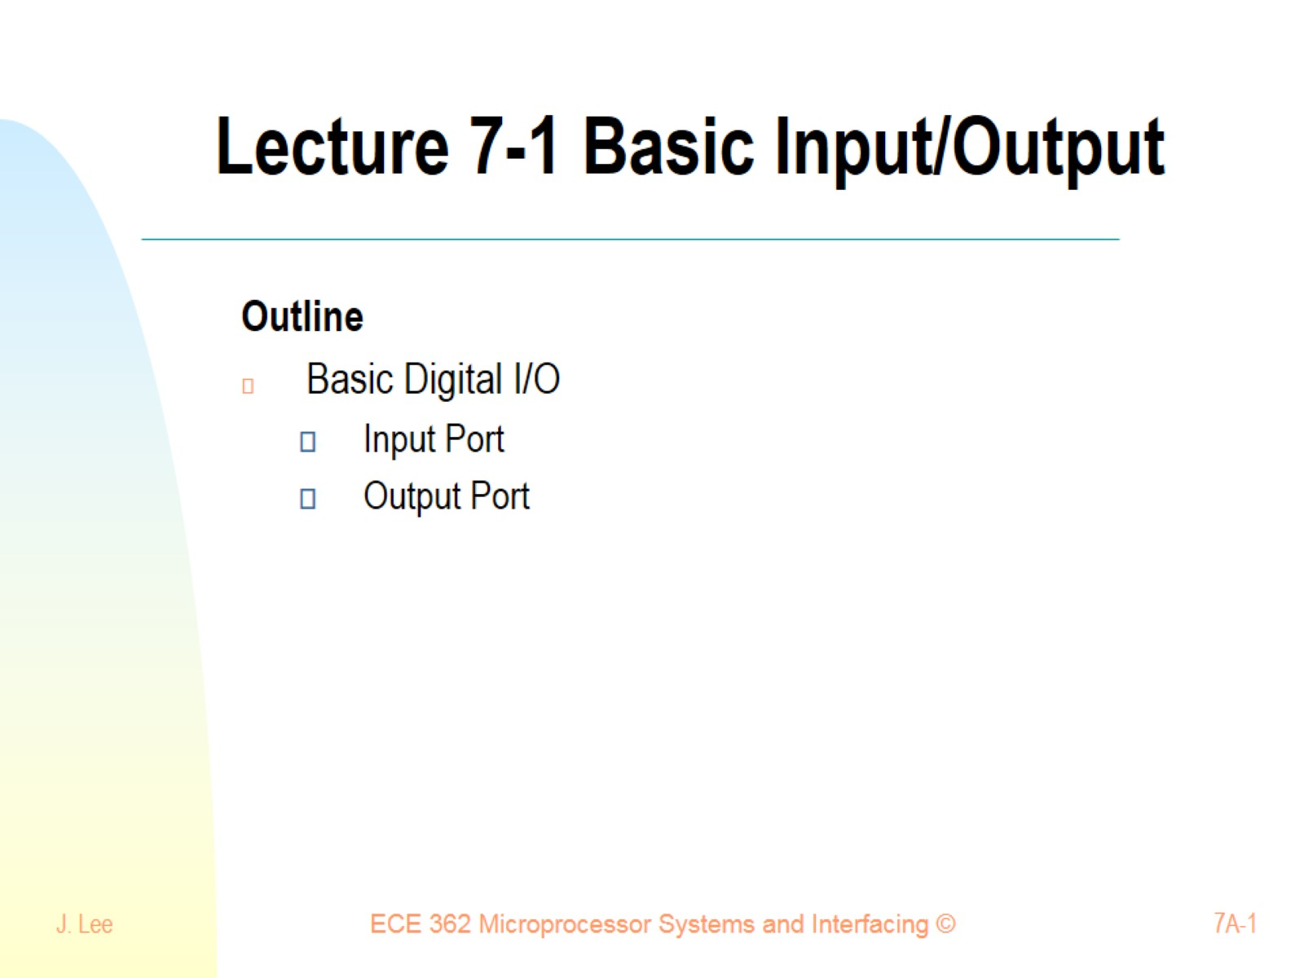
Lecture 7-1 Basic Input/Output

Slide 2
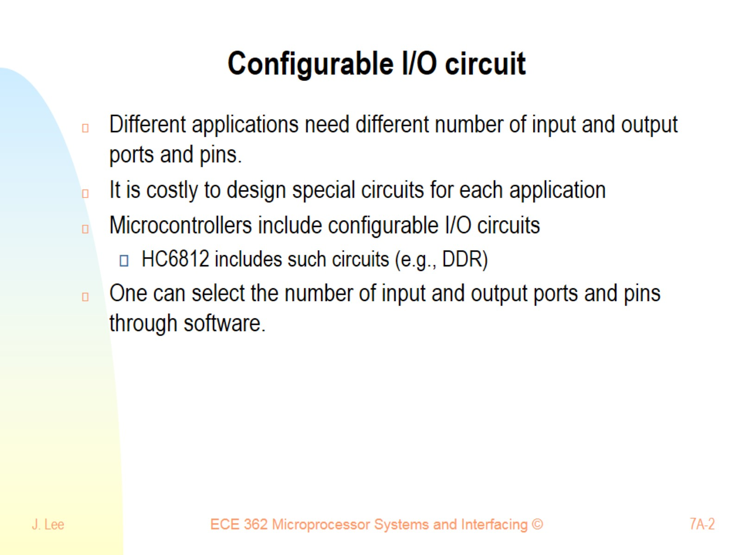
Configurable I/O circuit

Slide 3
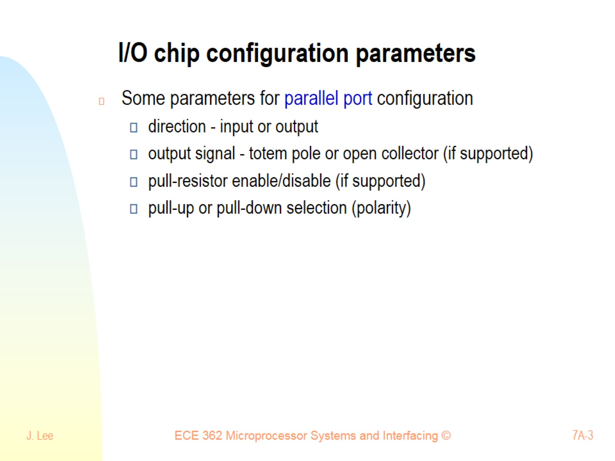
I/O chip configuration parameters

Slide 4
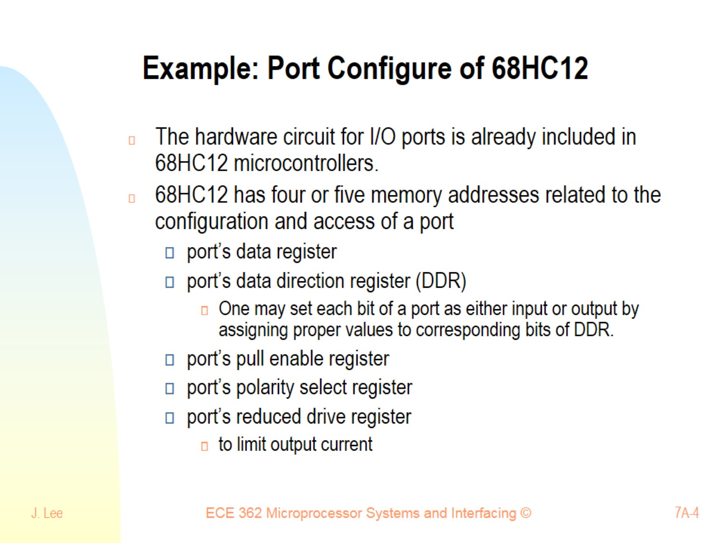
Example: Port Configure of 68HC12

Slide 5
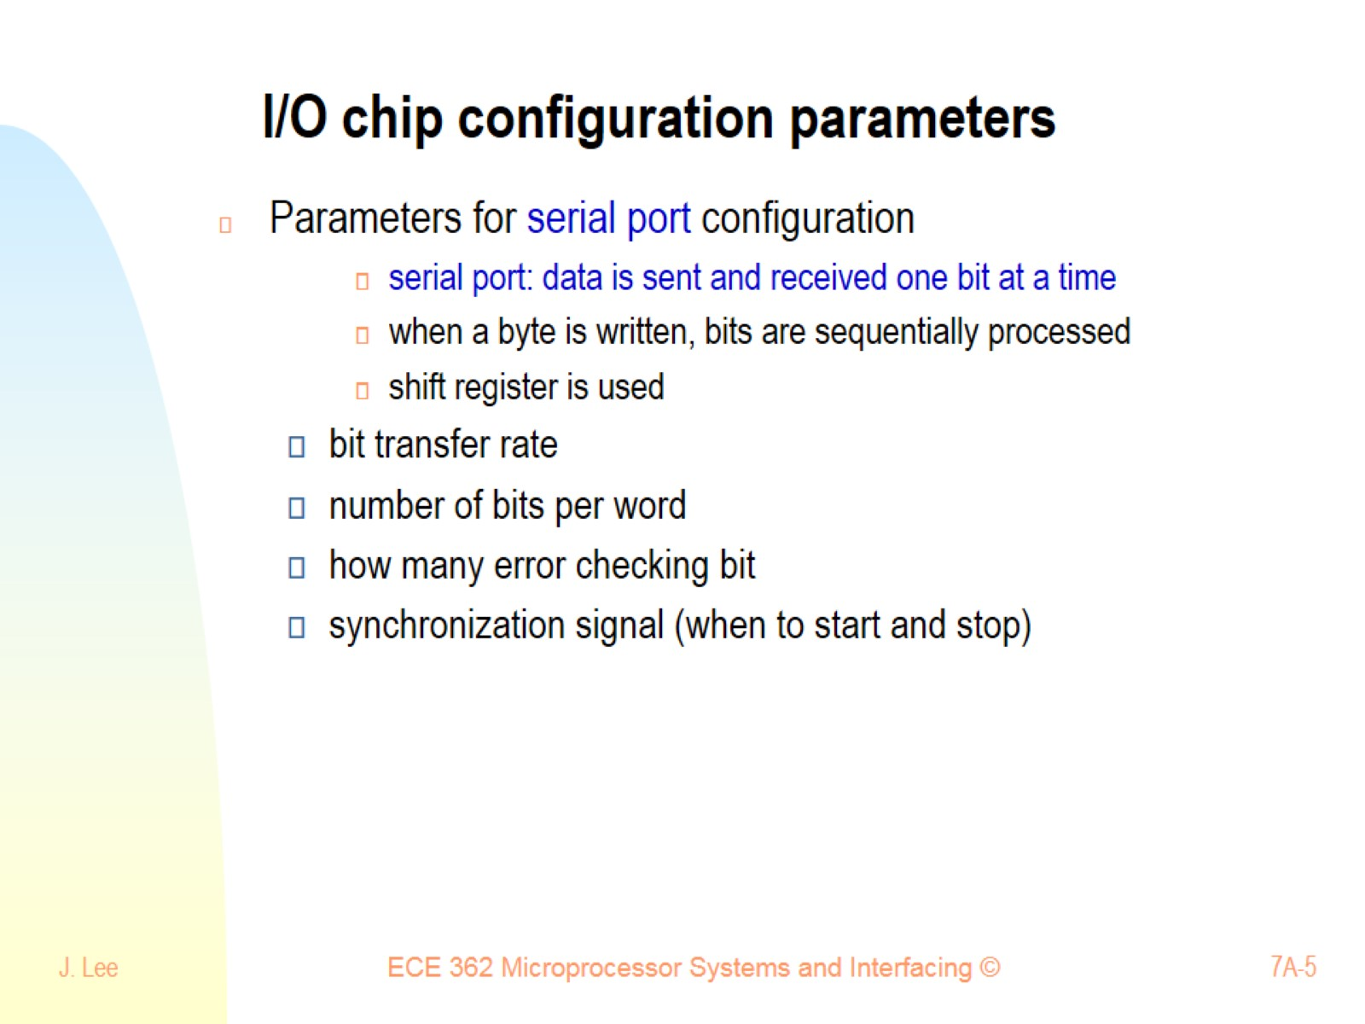
I/O chip configuration parameters

Slide 6
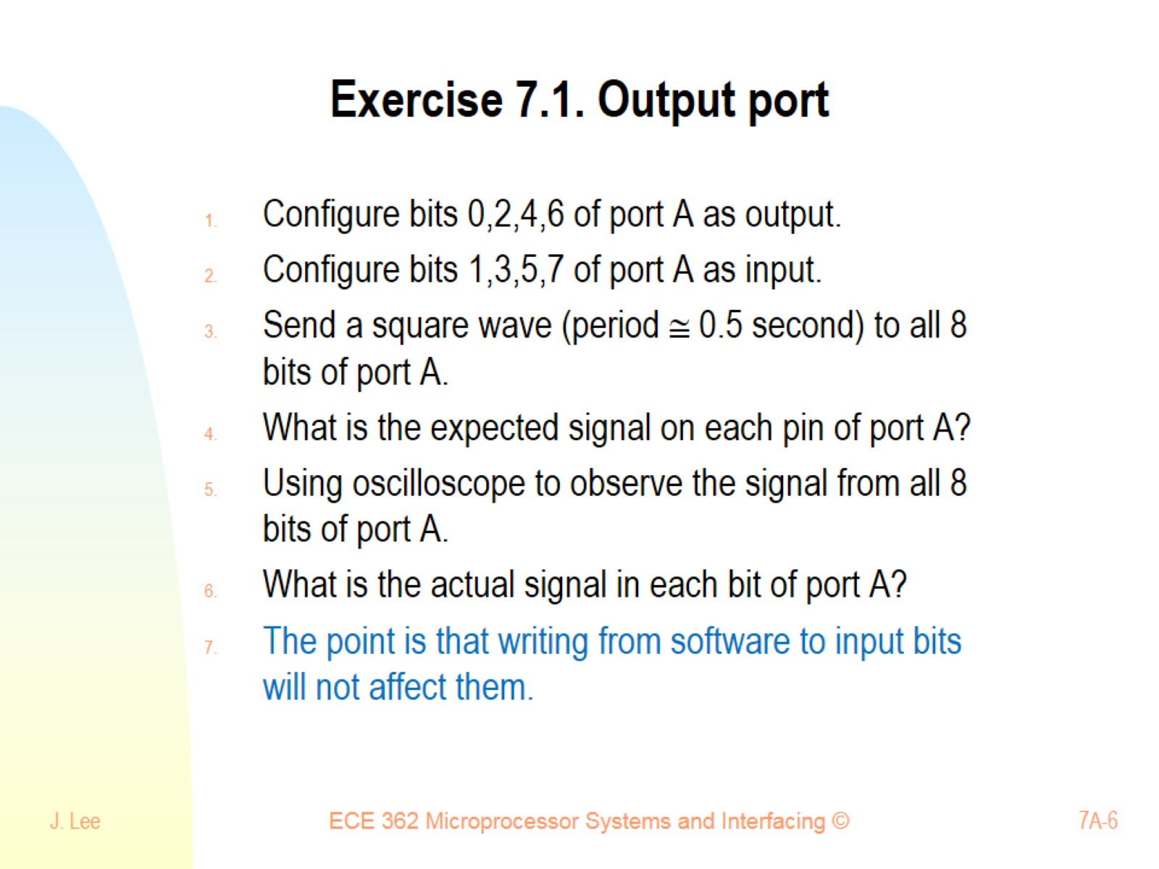
Exercise 7.1. Output port

Slide 7
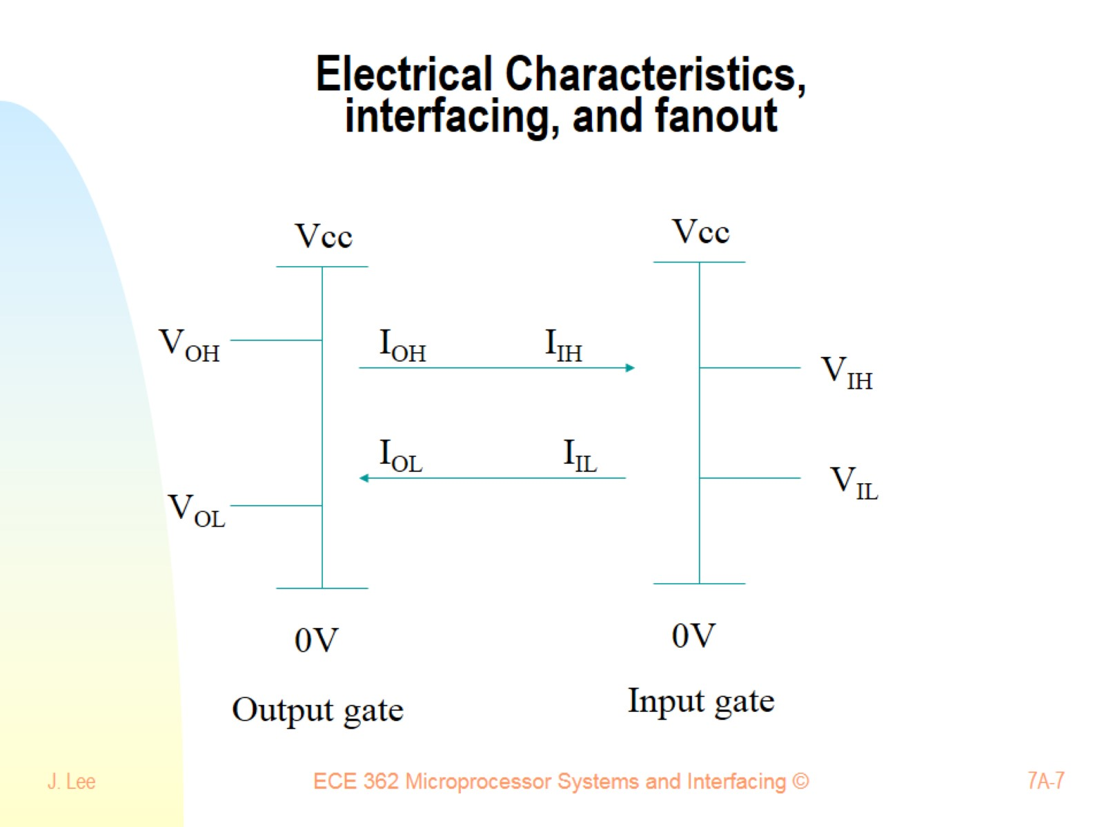
Electrical Characteristics, interfacing, and fanout

Slide 8
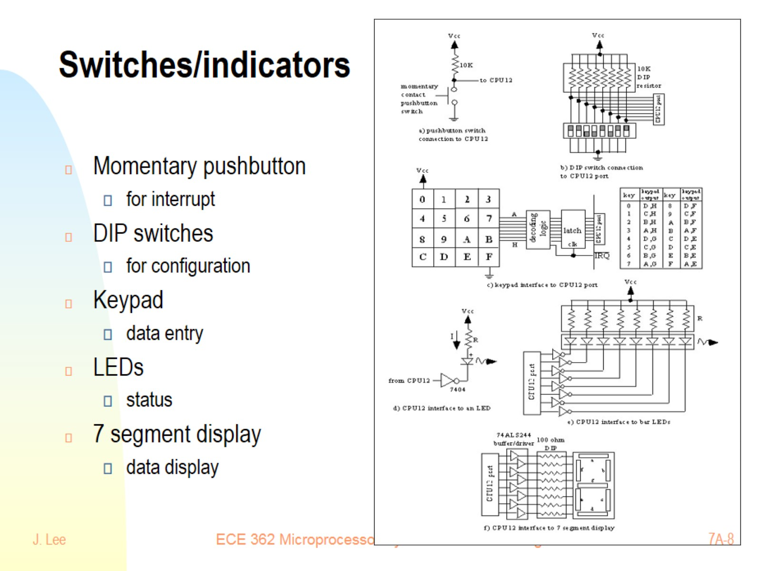
Switches/indicators

Slide 9
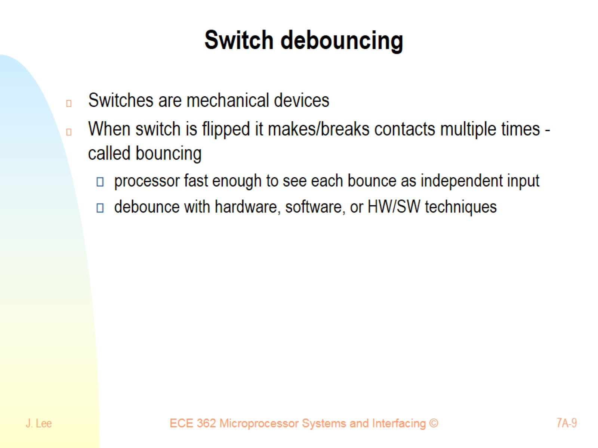
Switch debouncing

Slide 10
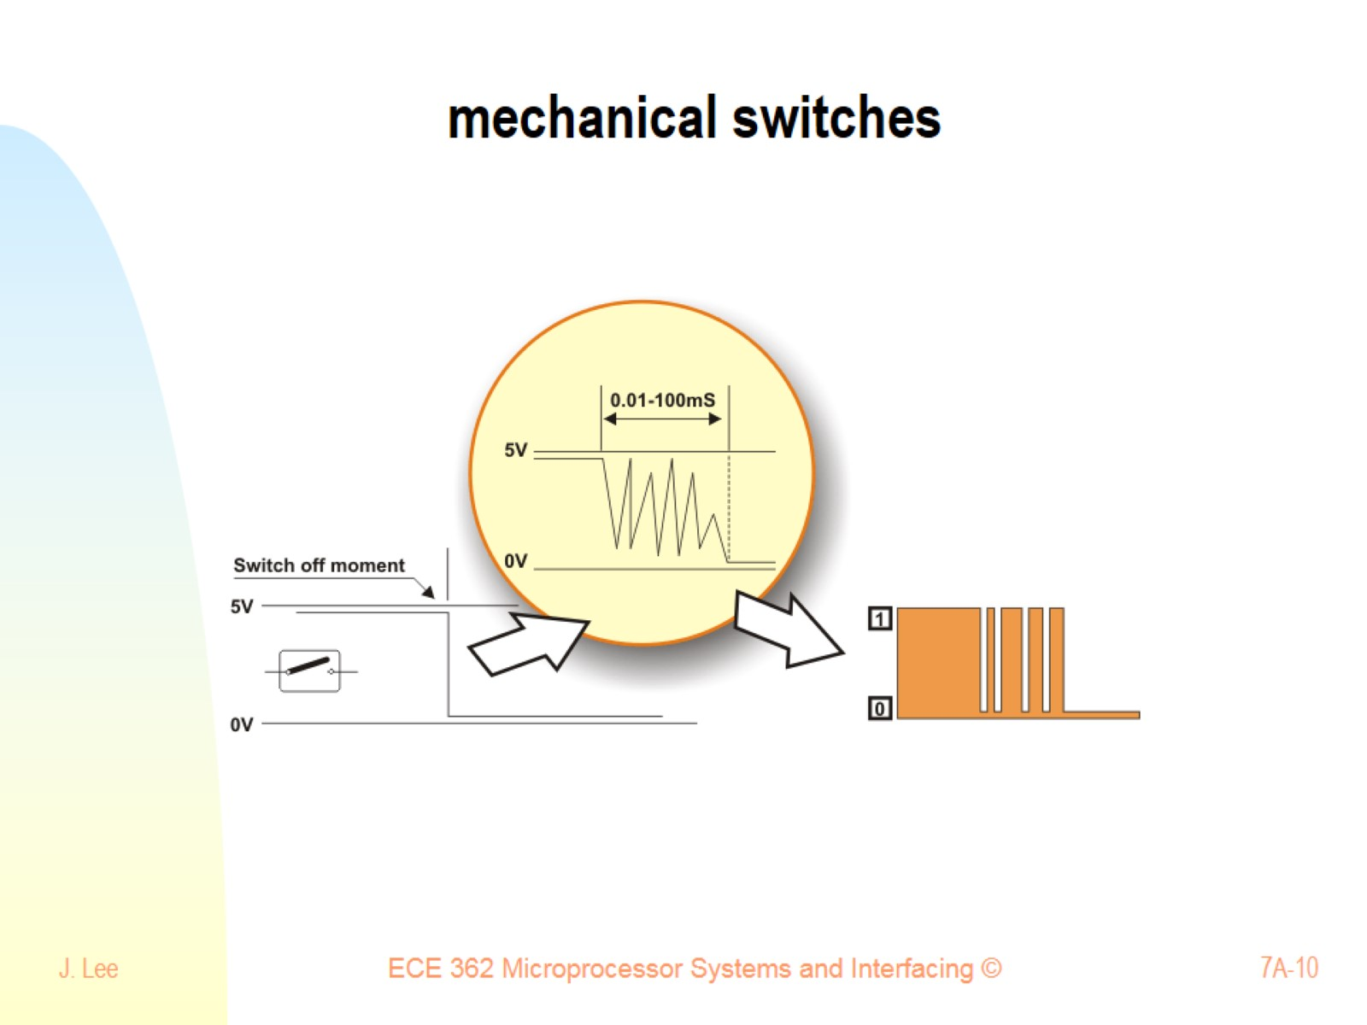
mechanical switches

Slide 11
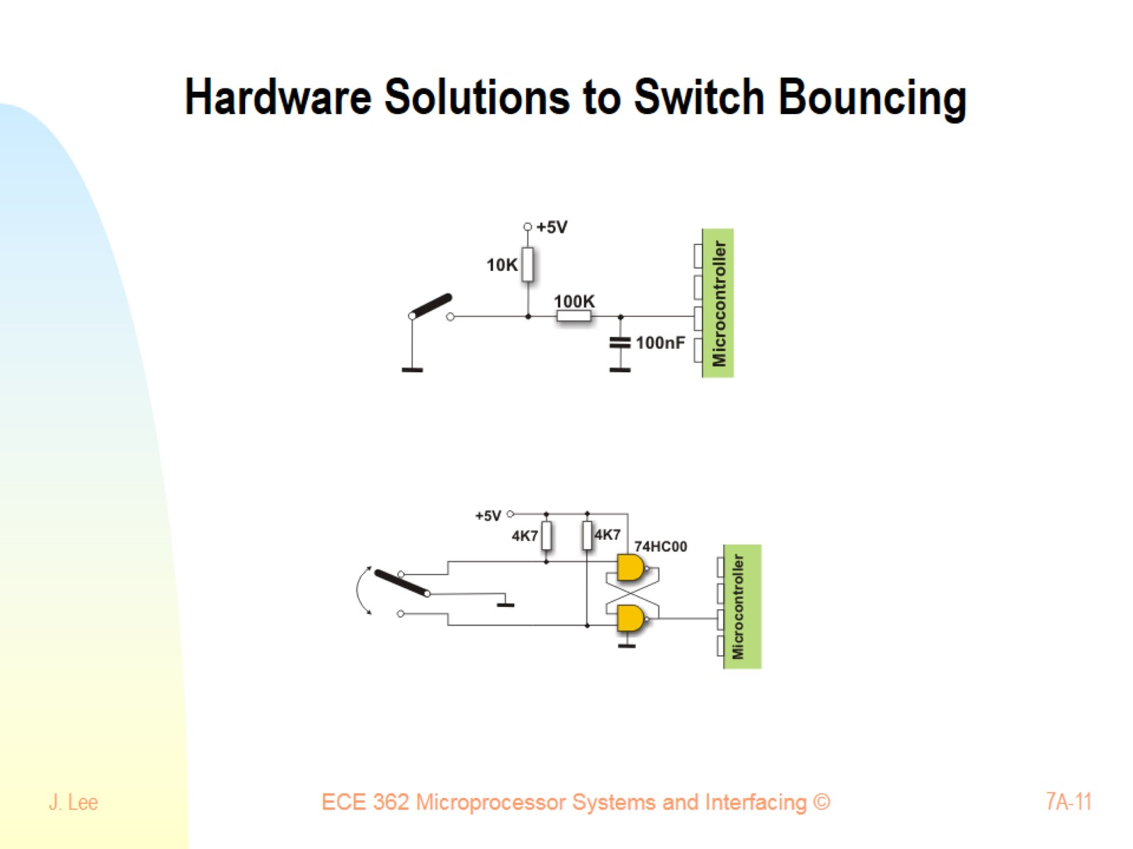
Hardware Solutions to Switch Bouncing

Slide 12
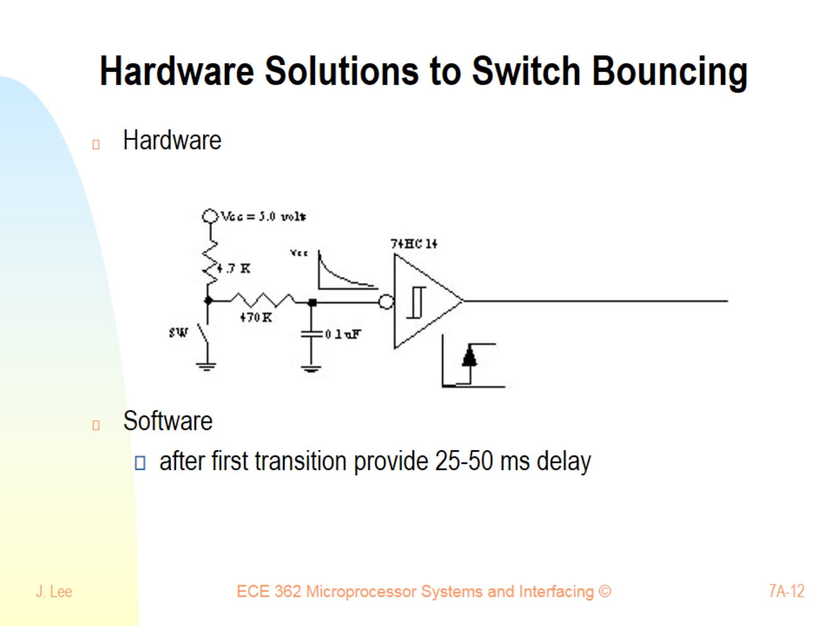
Hardware Solutions to Switch Bouncing

Slide 13
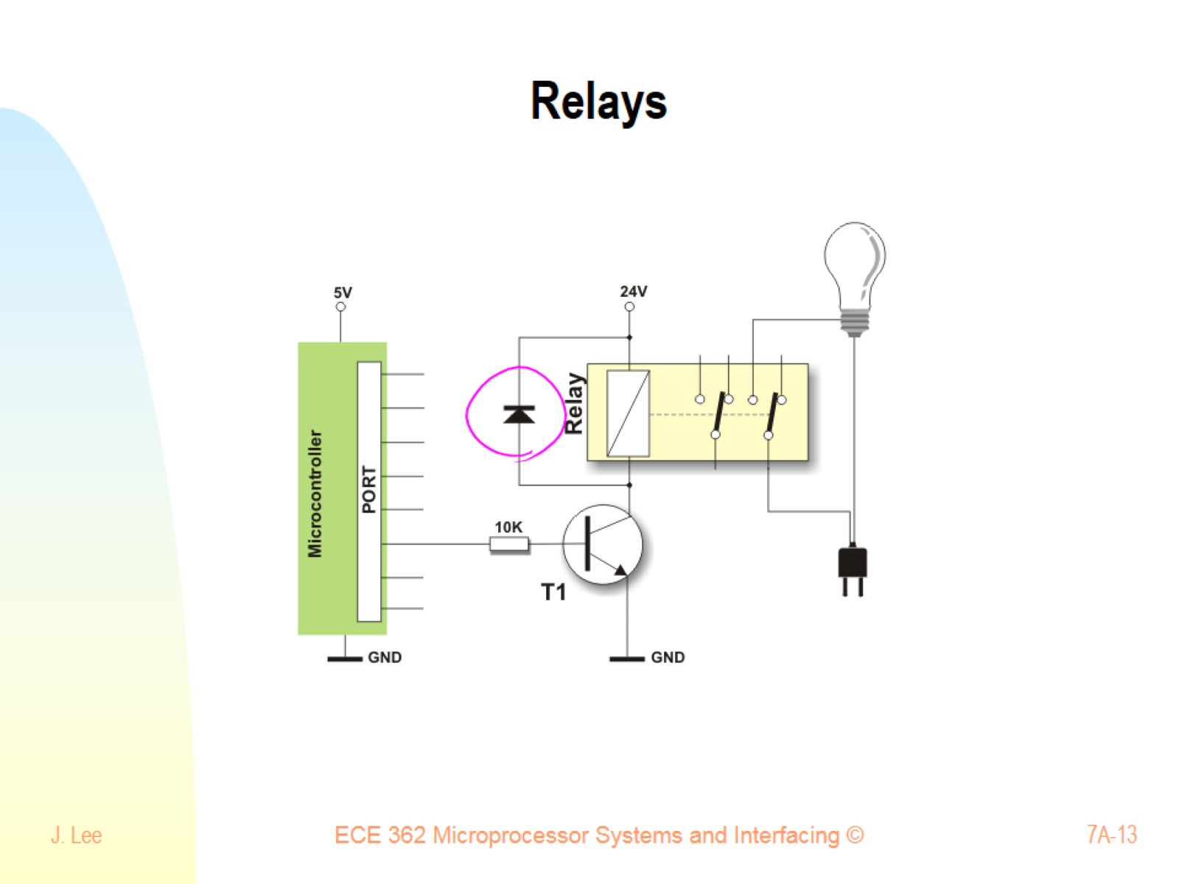
Relays

Slide 14
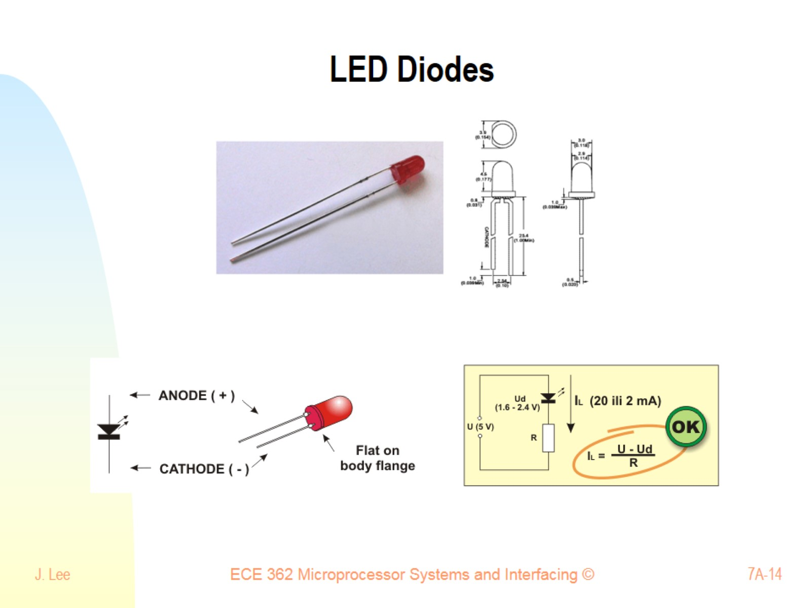
LED Diodes

Slide 15
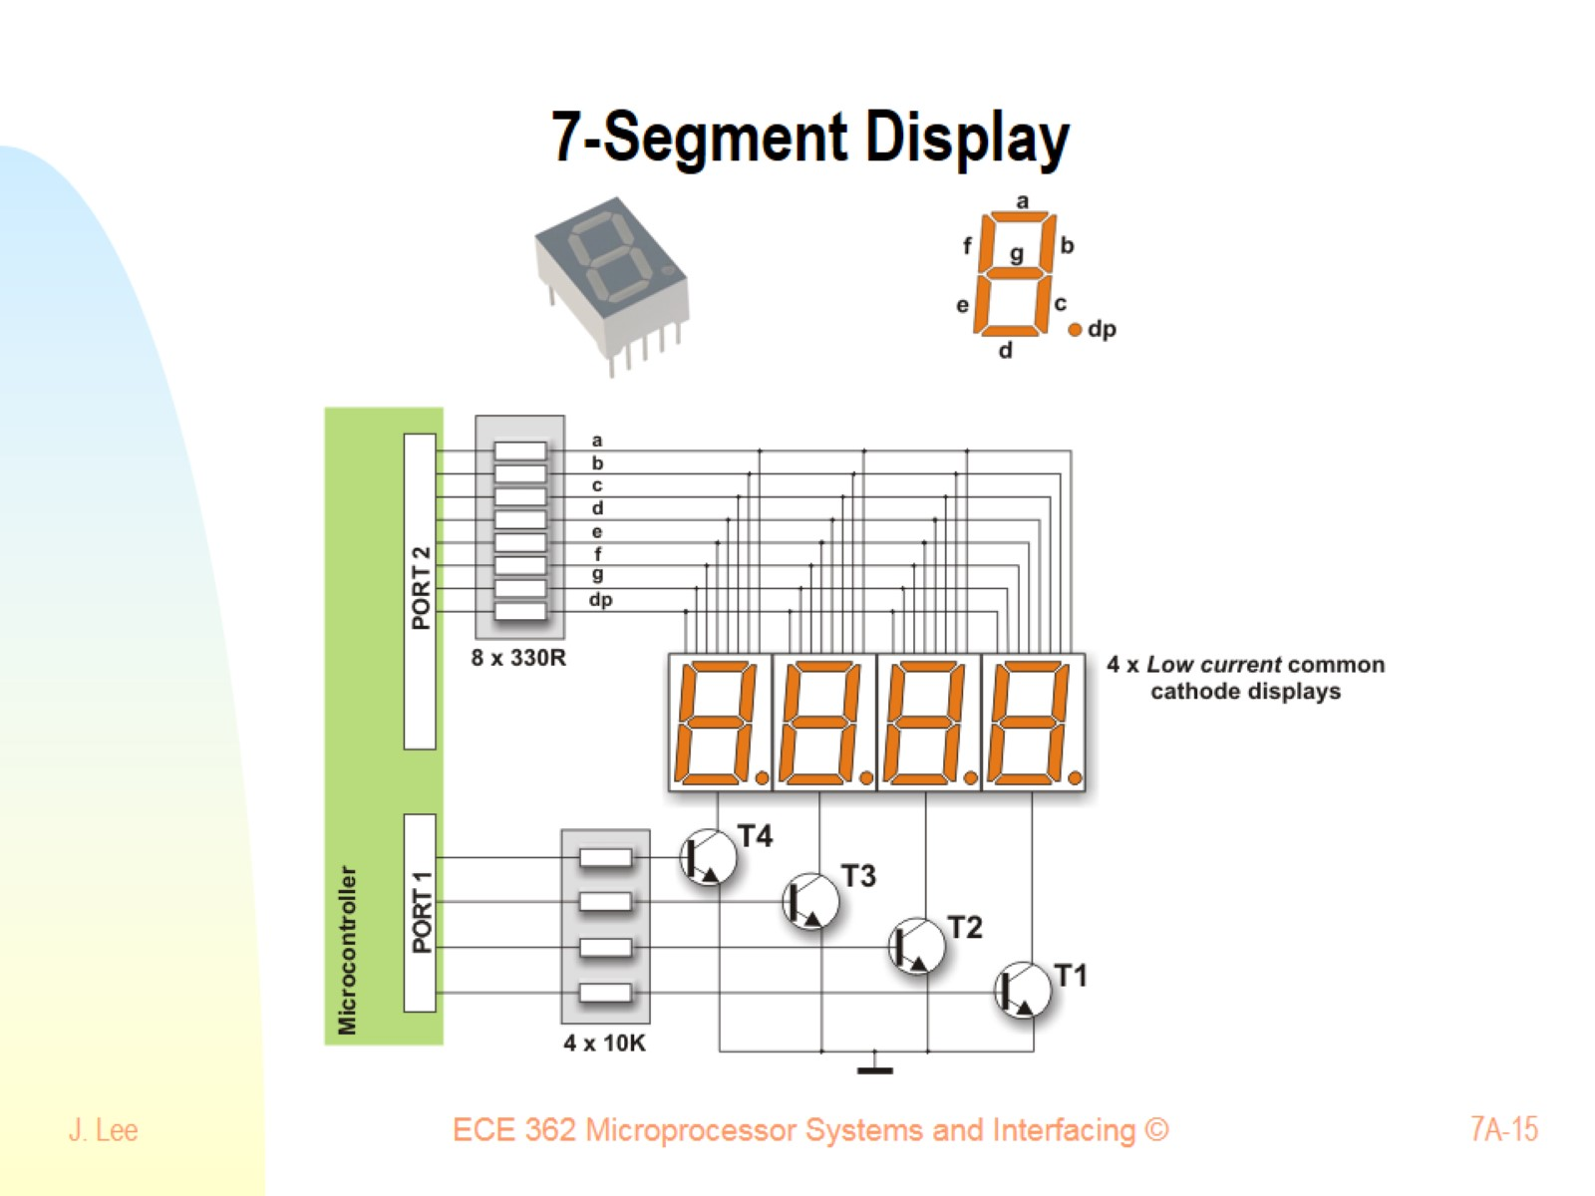
7-Segment Display

Slide 16
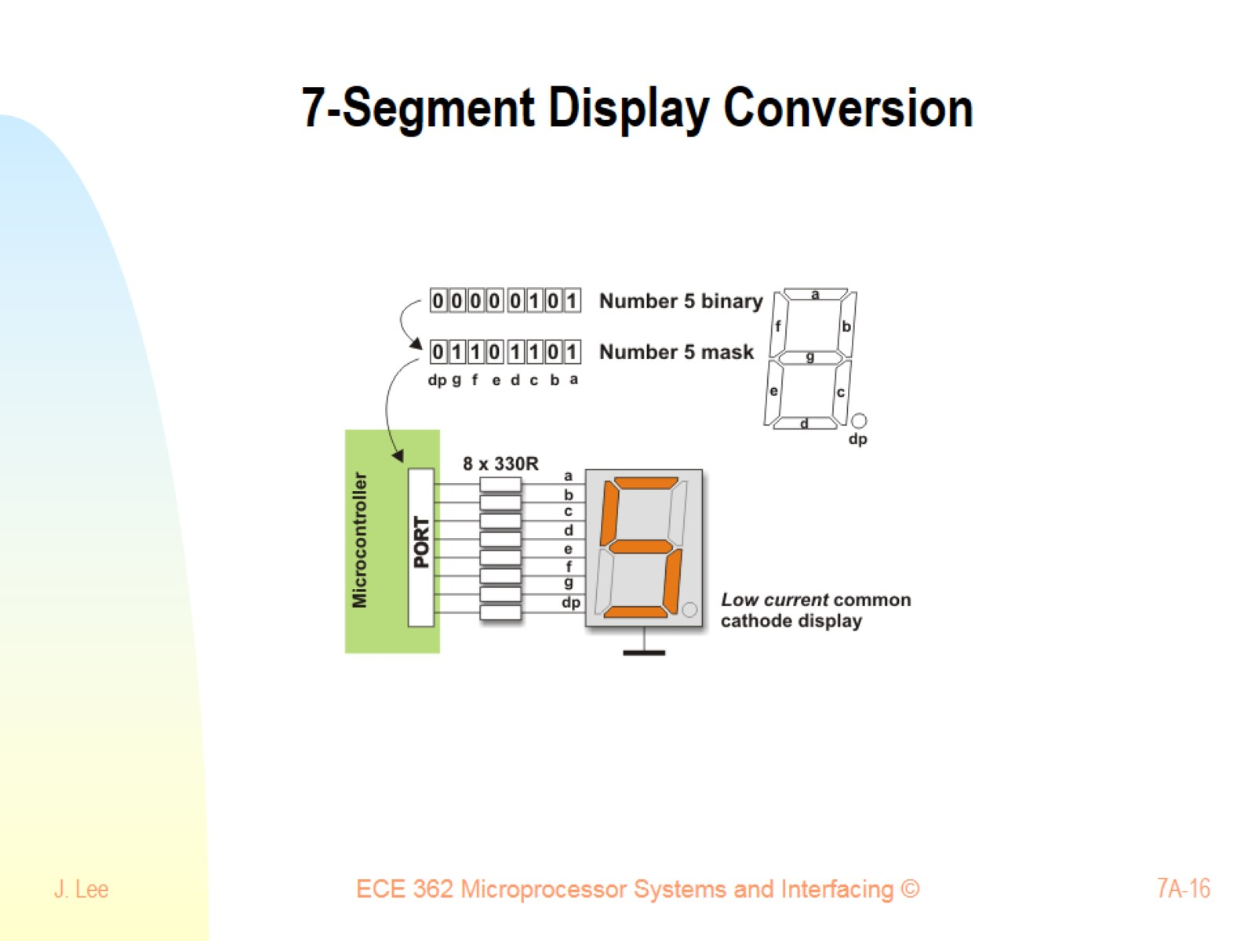
7-Segment Display Conversion

Slide 17
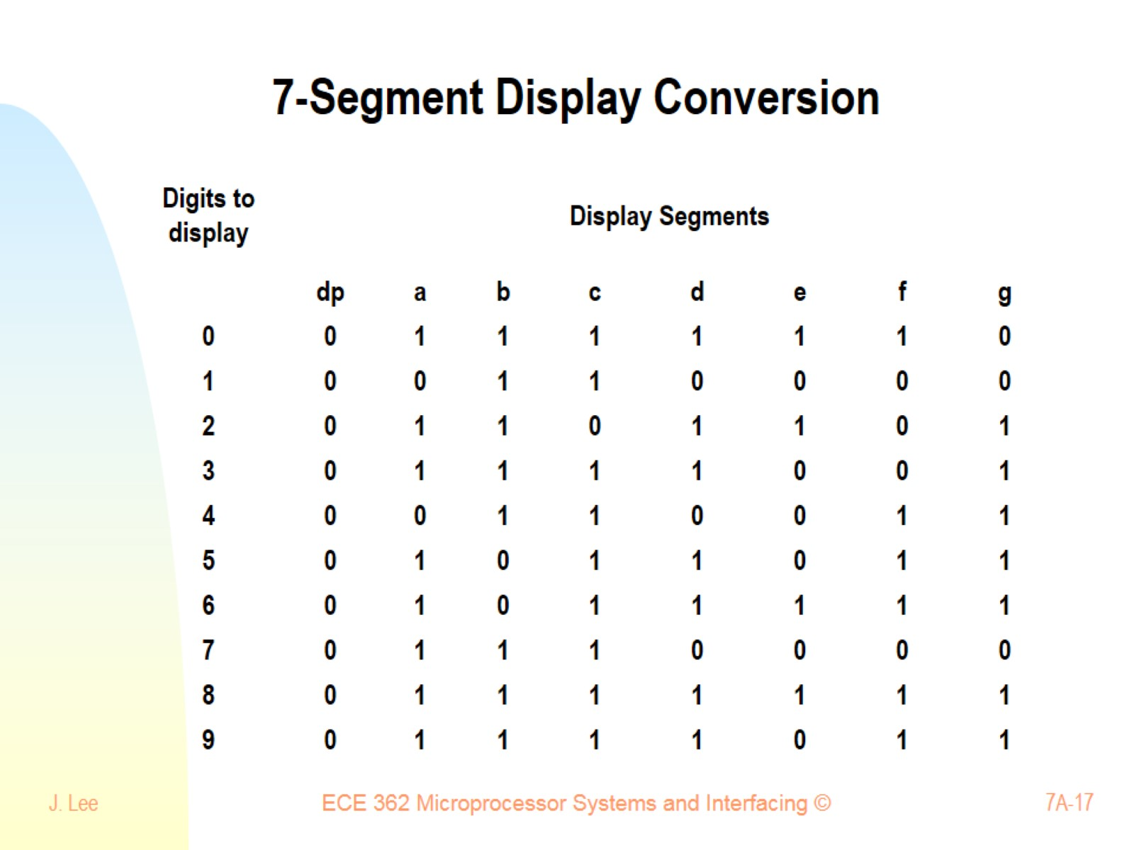
7-Segment Display Conversion

Slide 18
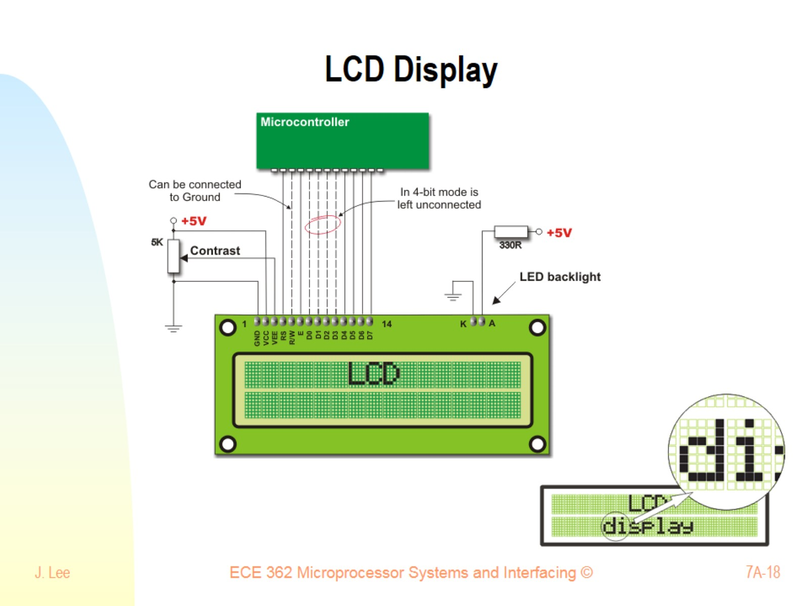
LCD Display

Slide 19
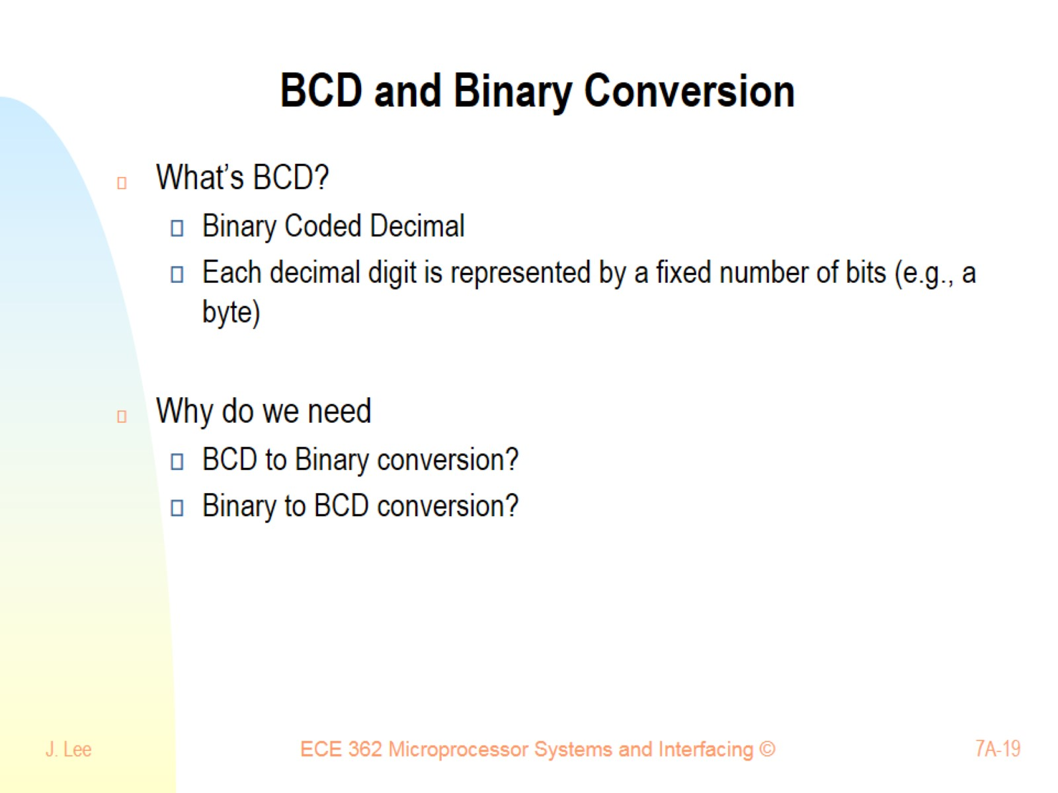
BCD and Binary Conversion

Slide 20
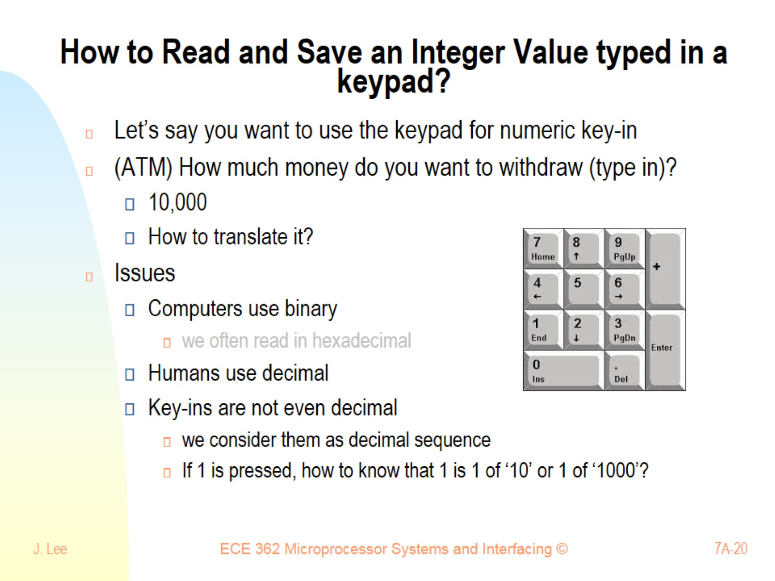
How to Read and Save an Integer Value typed in a keypad?

Slide 21
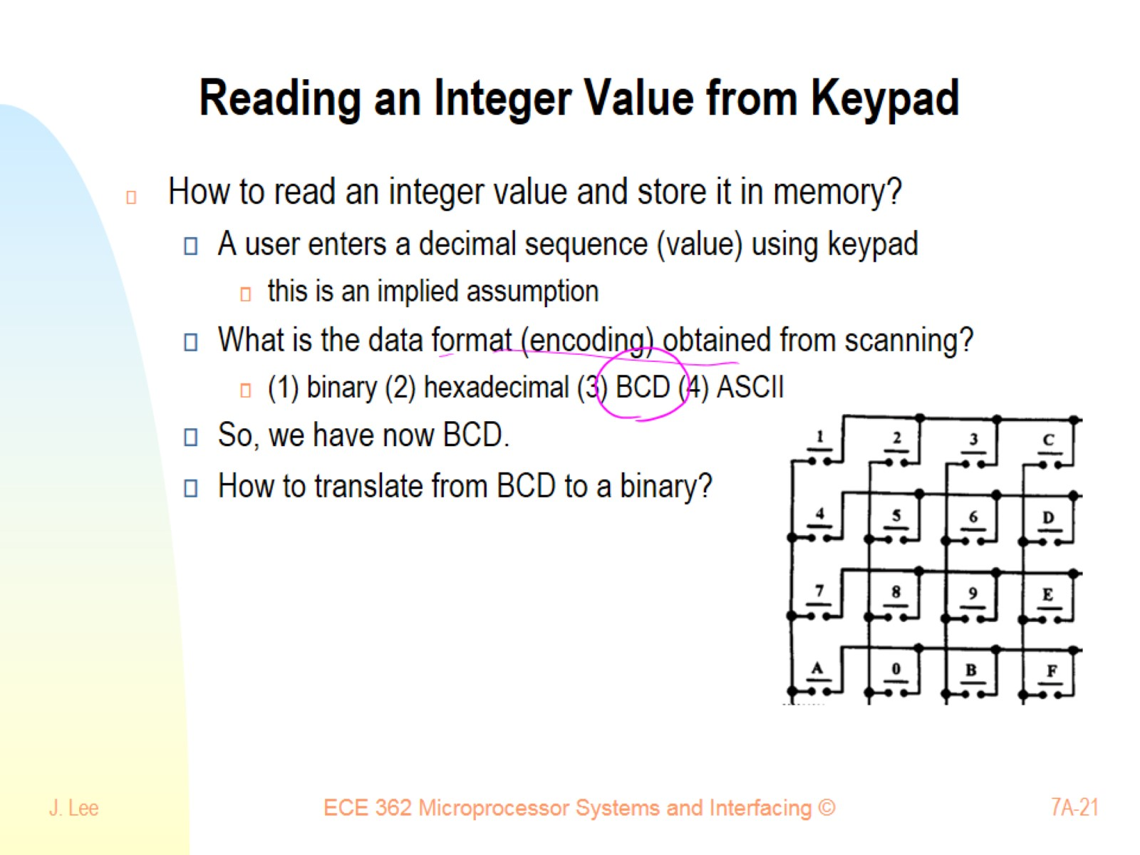
Reading an Integer Value from Keypad

Slide 22
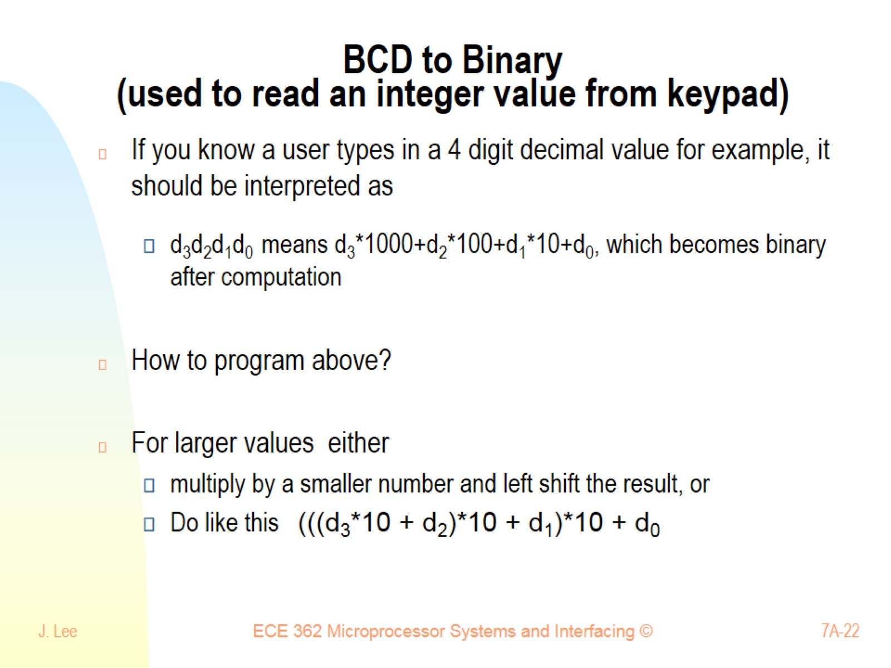
BCD to Binary (used to read an integer value from keypad)

Slide 23
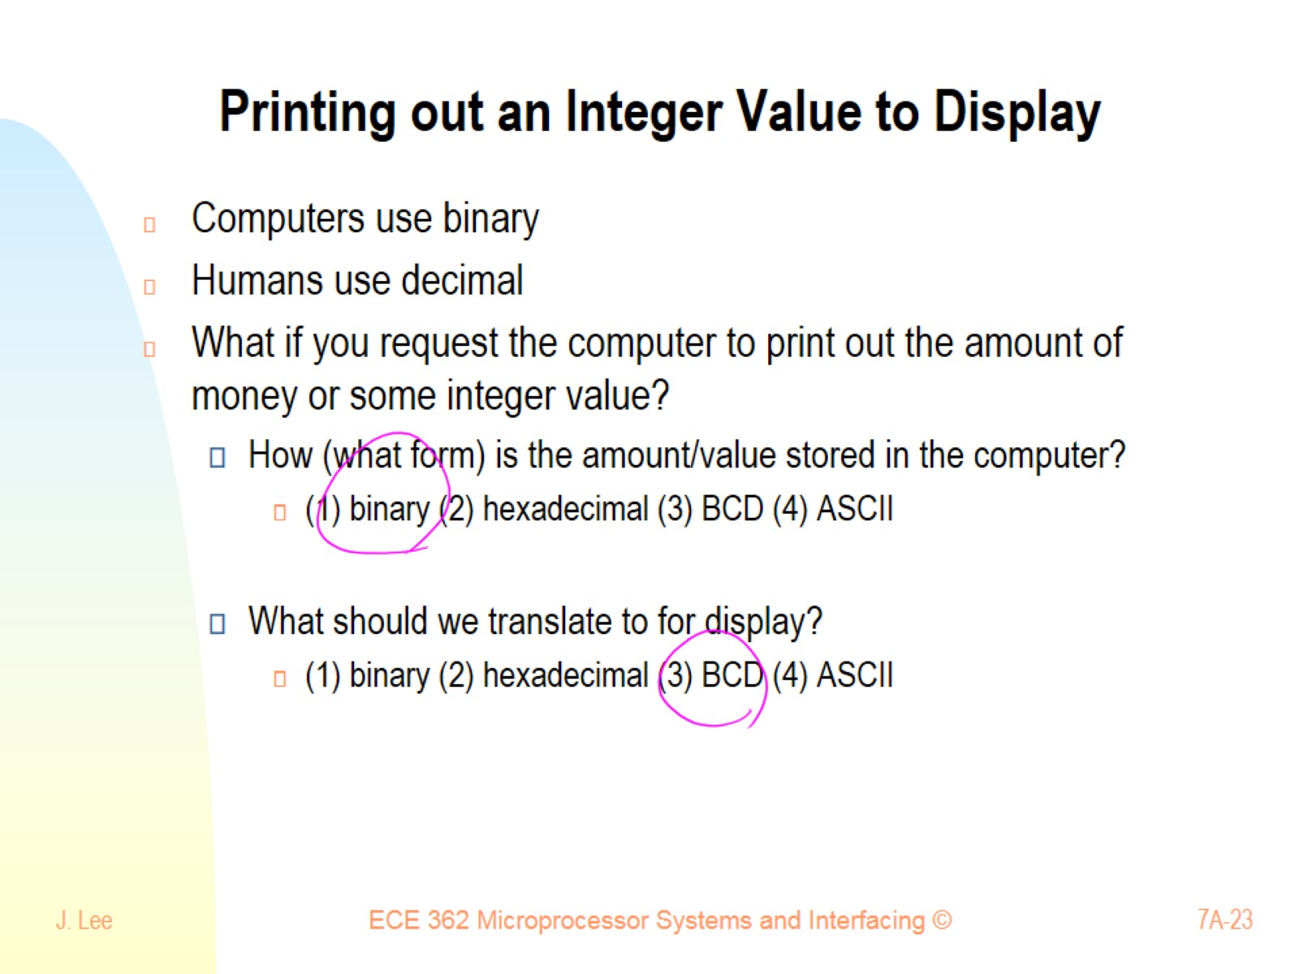
Printing out an Integer Value to Display

Slide 24
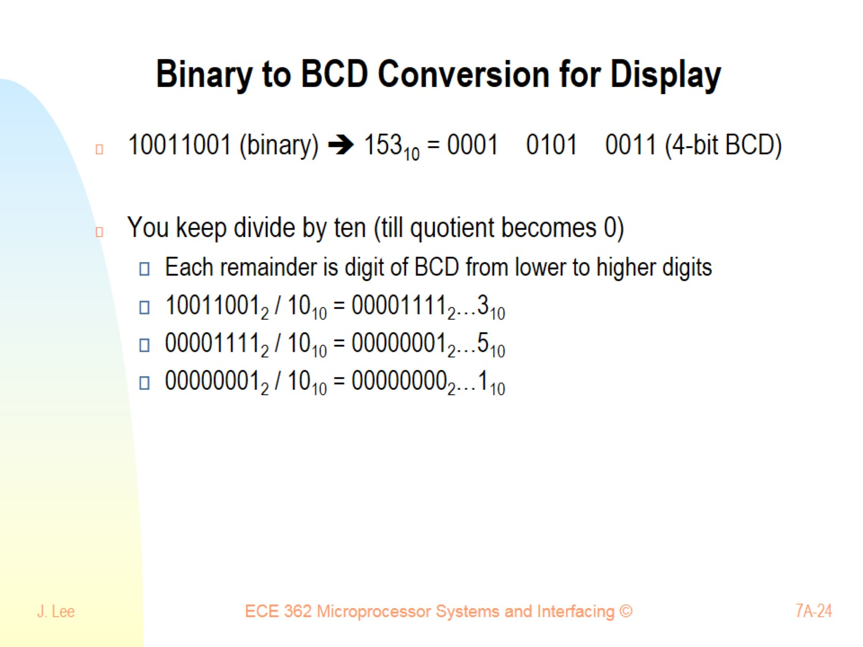
Binary to BCD Conversion for Display

Slide 25
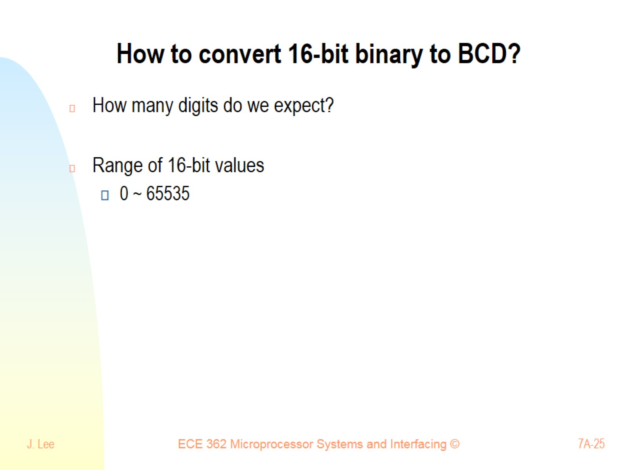
How to convert 16-bit binary to BCD?

Slide 26
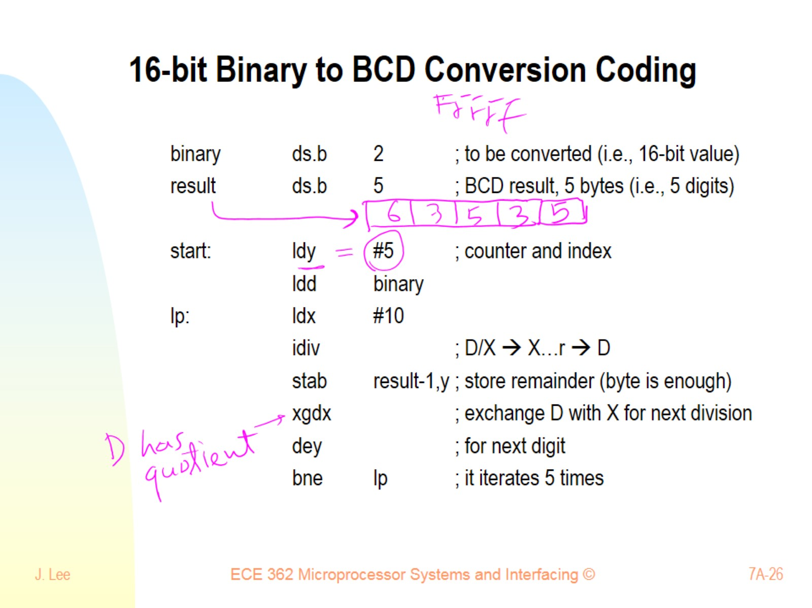
16-bit Binary to BCD Conversion Coding

Slide 27
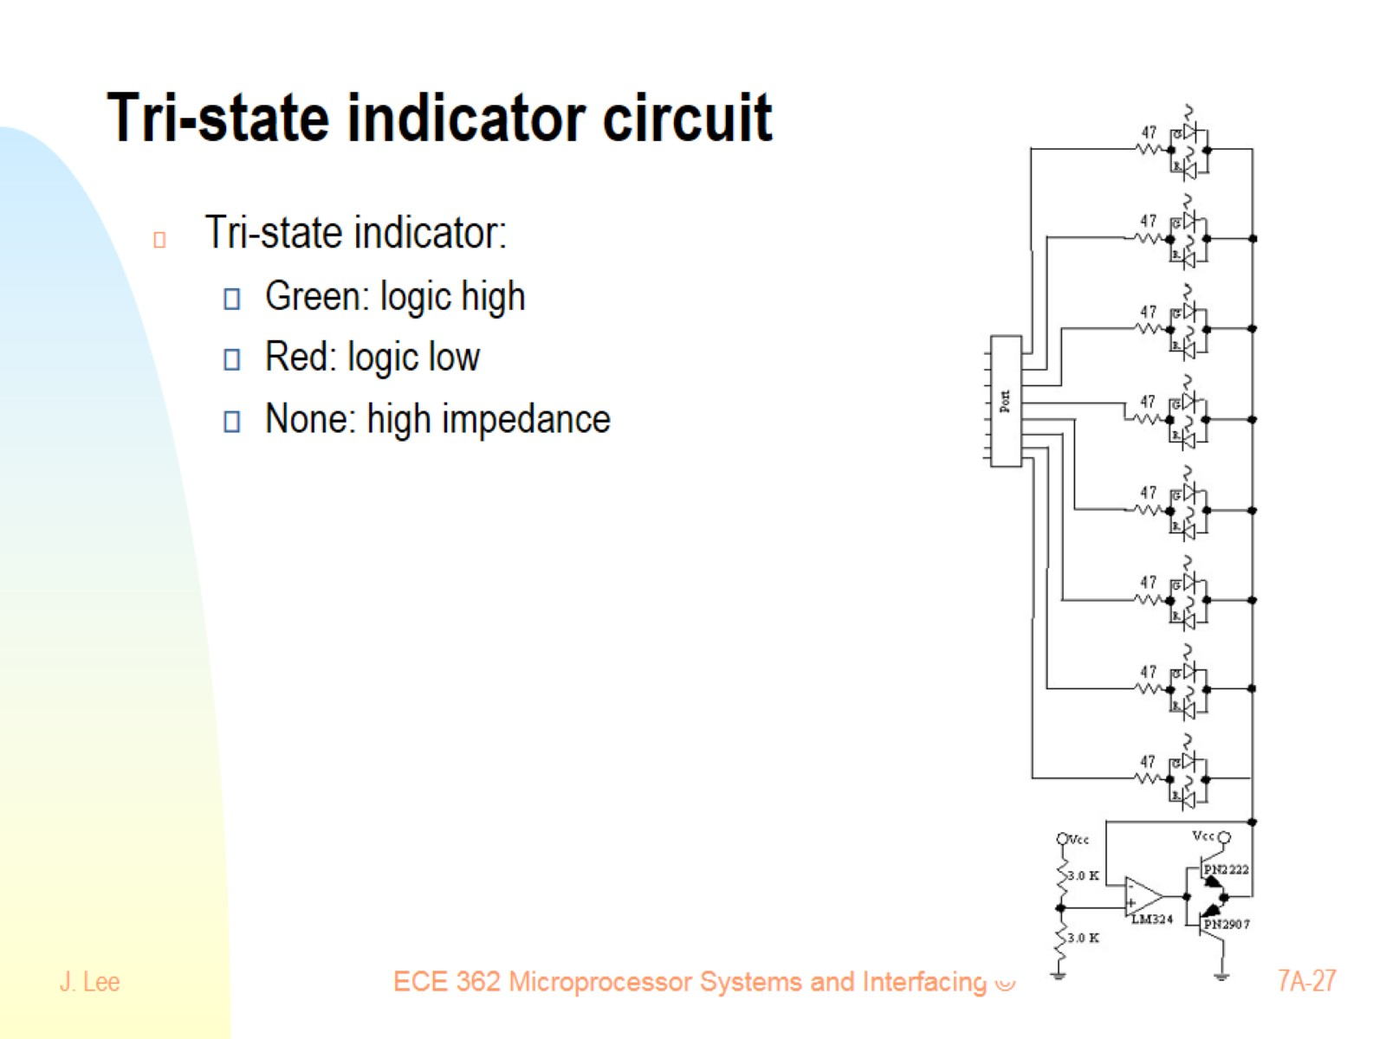
Tri-state indicator circuit

Slide 28
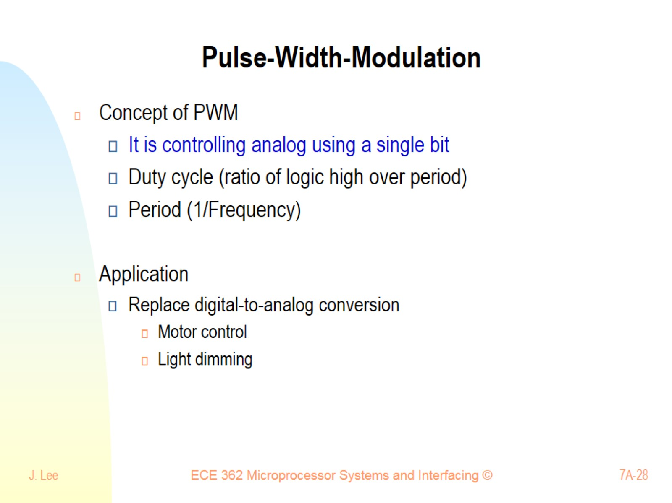
Pulse-Width-Modulation

Slide 29
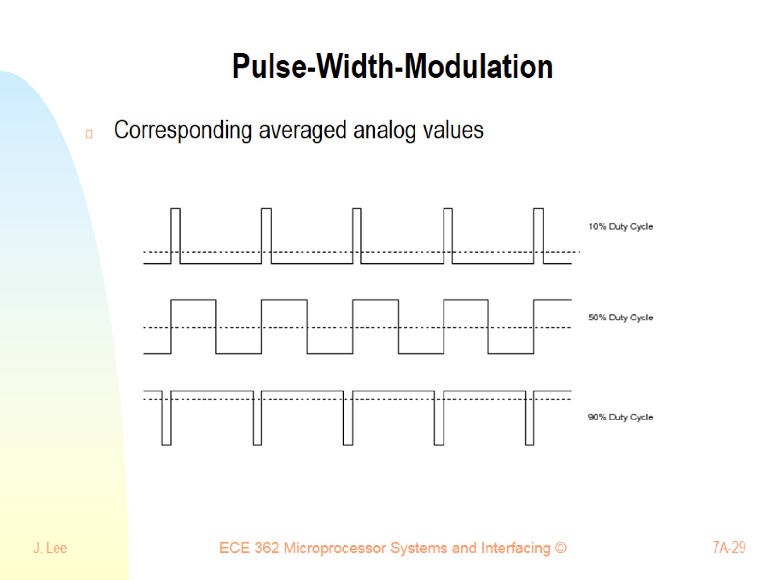
Pulse-Width-Modulation

Slide 30
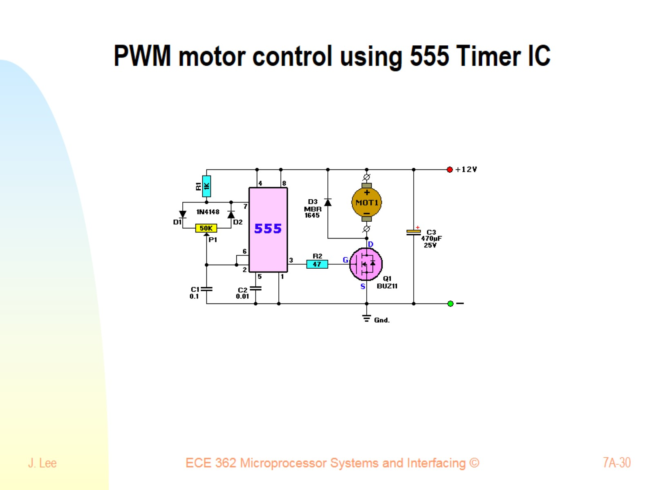
PWM motor control using 555 Timer IC

